Slide 2
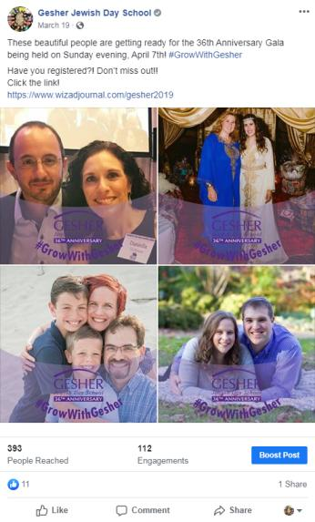
Create a buzz!
If you are celebrating a milestone year, celebrate all year long.
36 Ways to Get involved RH mailing
Facebook Frame
We also use Instagram, Twitter, Snapchat.
Giving Tuesday had a 24 hour matching gift
Founders Breakfast
Gala
Annual Meeting

Slide 3
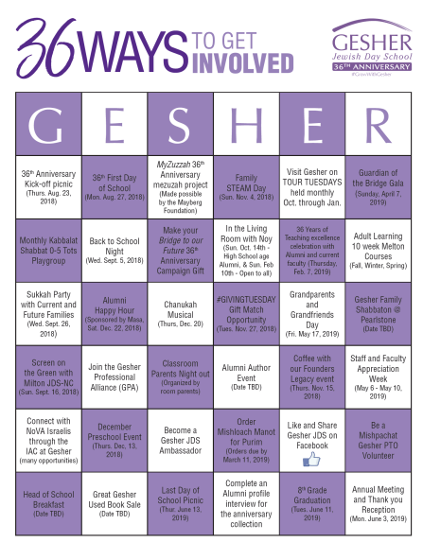

Slide 4
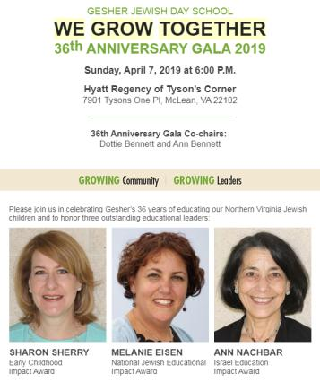

Slide 5
Is this a friendraiser or a fundraiser?
The year was full of friendraising, but the gala was a fundraiser with a friendraiser component.
The 36th Anniversary gala was the highest grossing gala in Gesher’s history.
In 2016, our gala grossed $90K with 250 attendees
In 2019, our gala grossed $313,366 with 305 attendees
Parent Ambassadors for every grade and every demographic
We encouraged parents who could purchase a full table to invite other families to their table.
Even if their ticket was paid for by the table, most made their own gift.
A generous alumni parent paid for two extra tables to ensure that every incoming Gesher parent (who had applied/enrolled for the coming school year) received a complimentary ticket to welcome them into the Gesher community. This was a huge success.
Agency Executives from specific partner agencies were invited on a courtesy ticket with guest
Faculty attended for free, guests at couvert rate.
Corporate and Private sponsorships available at many levels.

Slide 6
36th Anniversary Gala Committee
Gala Co-Chairs
Dottie Bennett and Ann Bennett
VP of Fundraising
Susan Haus
VP of Development
Julie Wallick
President of the Board
Vicki Fishman
Alumni Outreach
Sharon Rosenblatt and Marnie Kremer
Head of School
Dan Finkel
Director of Development
Jennifer Scher
Gala Grade Captains
Gan Katan (Jr. Kindergarten): Revital Melech and Sam Rubin
Gan (Kindergarten): Julie Toni and Joy Betaharon
Kitah Alef (1st grade): Laura and Daniel Strouse
Kitah Bet (2nd grade): Amy Lummer
Kitah Gimel (3rd grade): Francine and Jeff Rossen
Kitah Dalet (4th grade): Bianchi Suarez and Jamie Tabb
Kitah Hay(5th grade): Denise Michel and David Stein
Kitah Vav (6th grade): Micky and David Littman
Kitah Zayin (7th grade): Philip and Rachel Blumenthal
Kitah Chet (8th grade): Heidi Freeman
We also hired an event planner!
Let the event planner interact with the caterer, rentals, video equipment, set-up, entertainment. It will save your sanity.

Slide 7
Videos
Use your money wisely and for multiple purposes
We invested in two videos.
Honoree tribute video CLICK HERE
Gesher Promo Video CLICK HERE
We used the footage from the Gesher Promo video to spin off three additional Gesher mini videos for social media admissions marketing.
Gesher Green CLICK HERE
Gesher Academics CLICK HERE
Gesher Community CLICK HERE

Slide 8
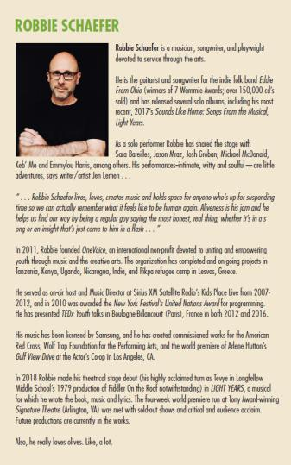

Slide 9
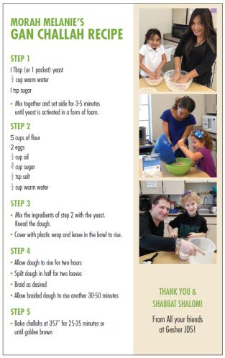
Our ticket sales and tribute ad journal was online only. Tributes and ads scrolled on the screen during the event gala and remain up for one year following the event.
https://www.wizadjournal.com/gesher2019
Every seat at the gala received the program and the challah recipe card.
The centerpieces had framed photos with quotes of Alumni, faculty, and staff with some small floral greenery and votive candles.

Slide 10
Gesher JDS Celebrates 36 Years!- to the Press - write a press release and include photos
On Sunday, April 7th, over 300 community members gathered together at the Hyatt Regency of Tyson’s Corner for Gesher Jewish Day School’s 36th Anniversary Gala. The gala, co-chaired by Dottie Bennett and Ann Bennett honored three incredible educators; Sharon Sherry with the Early Childhood Impact Award (presented by Avi West, Master Educator at The Jewish Federation of Greater Washington), Melanie Eisen with the National Educational Impact Award (presented by Paul Bernstein, CEO of PRIZMAH) and Ann Nachbar with the Israel Education Impact Award (presented by Howard Kohr, CEO of AIPAC and past president of Gesher).
In addition to the honorees, special acknowledgement was made to Gesher’s founders. "Our community honors its founders, the visionaries who got it all started. These visionaries said that a Jewish community is not a complete community without a Jewish Day School. The idea, the personal commitment and sweat equity that brought us from a classroom at Agudas Achim Congregation in 1982 to a professionalized, 21st century school of academic excellence, would not be possible without the passion, hard work and tenacity of parents, community leaders and funders… And we would remiss tonight as we gather as a community, if we did not acknowledge the very recent loss of three great members of the Gesher community, Steven Bodzin, Larry Shuman, and our beloved founder Marilyn Davis who so deeply believed in Jewish education. " - Ann Bennett, 36th Anniversary Gala Co-Chair
"Gesher JDS is known for being an excellent school with a welcoming culture, our neshama (soul) permeates our Northern Virginia (NoVA) Jewish community” Vicki Fishman, Board President. In this spirit and with thanks to a generous alumni parent, all new incoming parents for the fall of 2019 were able to attend the gala at no charge as a celebration and to welcome them to the Gesher community.
The evening included a stunning musical tribute dedicated to the honorees by Arielle Green, Gesher Class of 2008. Arielle is in her third year at the H.L. Miller Cantorial School at The Jewish Theological Seminary where she is expected to graduate from the cantorial program in 2020. Also elevating the educational and jewish spirit was a musical storytelling performance by local artist Robbie Schaefer.
As we move into the next 36 years, “Gesher is the hub for Jewish education in Northern Virginia; as a hub, we have a responsibility to share and leverage our knowledge and educational resources to grow and strengthen our local community." Vicki Fishman, Gesher JDS Board President.
May we all go from strength to strength.
Photos attached

Slide 11
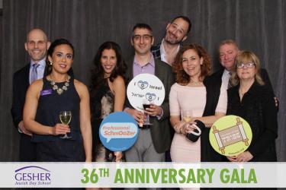
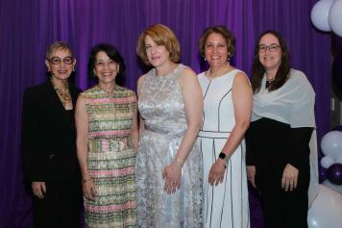
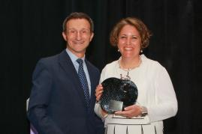
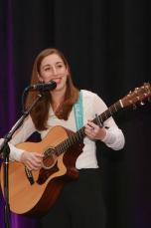
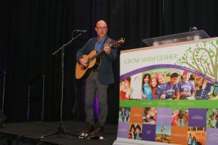
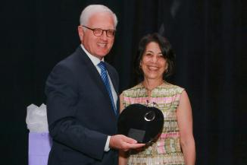
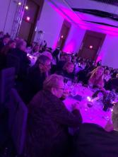
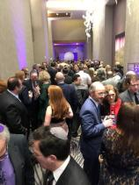
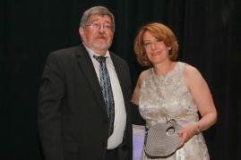
If you don’t document it,
it didn’t happen! TAKE PHOTOS ALL THE TIME and EVERYWHERE

Slide 12
Questions??
To discuss milestone events or general development strategies, feel free to reach out!
Jennifer A.Scher
Director of Institutional Advancement
Gesher Jewish Day School
703-962-9209 jscher@gesher-jds.org

