Slide 1
Jewish Community Day School of Rhode Island
Small Schools big event
Alison Walter, Development Director

Slide 2
JCDSRI AT A GLANCE
70 Students in Pre-K through 5th grade – Average class size is 11
Mission statement: The Jewish Community Day School of Rhode Island prepares confident, collaborative, critical thinkers for the twenty-first century. We employ a progressive curriculum that nurtures each student’s innate creativity and curiosity while promoting academic rigor and developing personal character. Supported by an inclusive community of families and staffed by an outstanding team of educators, JCDSRI reflects the values and ethics of a vibrant and diverse Jewish community.
Raise $250,000 Annually and an additional $100,000 in grants
Currently in the quiet phase of a new Endowment Campaign to raise $3 million over 5 years.

Slide 3
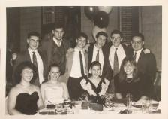
Planning for the 40th
Board discussion
Parents Association
Chairs
Committee
Friendraiser VS. Fundraiser
Expectations of Current Families
Alumni
Community Support
Marketing – Video’s
Cross marketing
Social Media

Slide 4
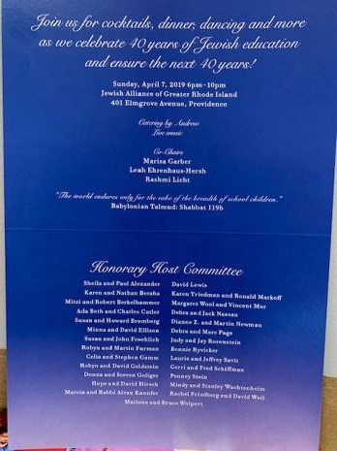
PERSONALIZED THANK YOU NOTES WITH PICTURES
Dear Paul,
Thank you for celebrating at the 40th Anniversary Gala with us. What an evening! It was wonderful to have alumni, alumni families, current families, teachers and community supporters sharing the love for our ASDS/JCDS. Almost 200 people came together to reminisce and look forward toward our exciting future. Forty years and over five hundred graduates later, our impact can be felt in communities near and far. It’s hard to imagine where we would be without our strong community of supporters, and we look forward to making more memories in the future. Please consider a donation in the enclosed envelope. Thank you for your tremendous commitment and support. We look forward to partnering with you in the future.
Wishing you and your family a meaningful Passover.
With gratitude,
Andrea Katzman Alison Walter
Head of School Development Director

Slide 5
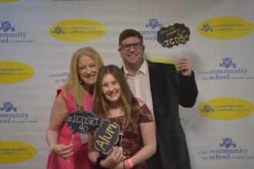
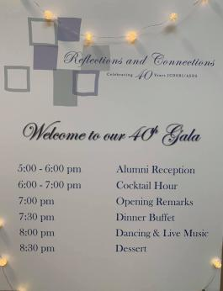
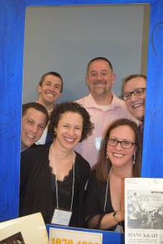
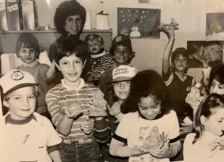
6-7pm Step and Repeat with pictures
Living Museum
7pm - Move party into the social hall
7:05pm - Oren Kaunfer Welcoming!
7:10pm - Reese and Ella
7:15 - Video (8 mins)
7:23 - Andrea Closing and Thank You’s
7:25 - Dinner Buffet is opened
8:00-10pm - Band
8:30pm - Dessert in the lobby
10pm - Goodnight and clean up
Notes:
*Change to Spring Fun for southern Hemisphere
Include pictures of the first term of school. Students working together/students reading books/working on projects or art, etc.

Slide 6
Questions and More Information
Alison Walter
awalter@jcdsri.com
401-751-2470

